Slide 1
Wnt10a Cas9-KO Strategy
Designer: Reviewer: Design Date:
Designer: Huan Wang Reviewer: Yumeng Wang
Design Date: 2021-7-27

Slide 2
Project Overview
Project Name Wnt10a
Project type Cas9-KO
Strain background C57BL/6JGpt

Slide 3
Knockout strategy
This model will use CRISPR/Cas9 technology to edit the Wnt10a gene. The schematic diagram is as follows:
1
2
3
4
1
3
4

Slide 4
Technical routes
➣ The Wnt10a gene has 2 transcripts. According to the structure of Wnt10a gene, exon2 of Wnt10a-201(ENSMUST00000006718.15) transcript is recommended as the knockout region.The region contains 263bp coding sequence. Knock out the region will result in disruption of protein function. ➣ In this project we use CRISPR/Cas9 technology to modify Wnt10a gene. The brief process is as follows: CRISPR/Cas9 system were microinjected into the fertilized eggs of C57BL/6JGpt mice. Fertilized eggs were transplanted to obtain positive F0 mice which were confirmed by PCR and sequencing. A stable F1 generation mouse model was obtained by mating positive F0 generation mice with C57BL/6JGpt mice.

Slide 5
Notice
➣ According to the existing MGI data,mice homozygous for a knock-out allele exhibit taurodontism, supernumerary molars, small molars and misshapened crowns. Mice homozygous for a conditional allele activated in Krt14+ cells also exhibit decreased basal cell proliferation affecting the tongue, sweat glands and nails. ➣ The Wnt10a gene is located on the Chr1. If the knockout mice are crossed with other mice strains to obtain double gene positive homozygous mouse offspring, please avoid the two genes on the same chromosome. ➣ This strategy is designed based on genetic information in existing databases.Due to the complexity of biological processes,all risk of the gene knockout on gene transcription, RNA splicing and protein translation cannot be predicted at the existing technology level.

Slide 6
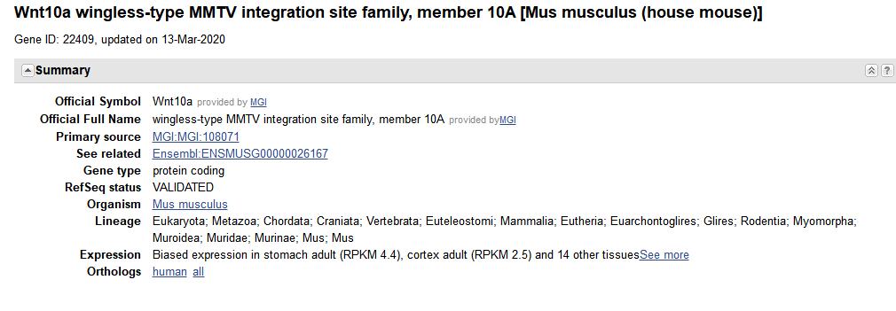
Gene information （NCBI）

Slide 7
Transcript information（Ensembl）
The gene has 2 transcripts,all transcripts are shown below:
The strategy is based on the design of Wnt10a-201 transcript,the transcription is shown below:

Slide 8
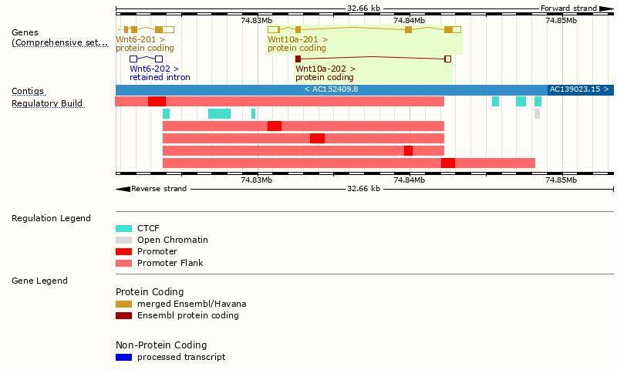
Genomic location distribution

Slide 9
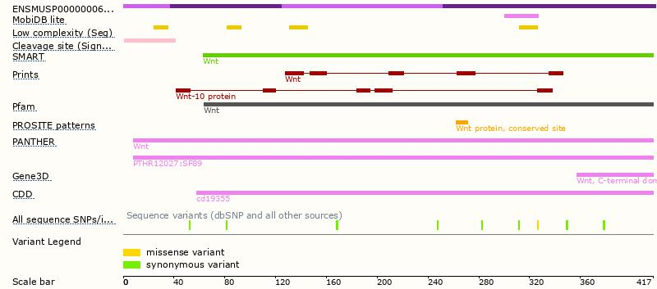
Protein domain

Slide 10
Mouse phenotype description(MGI )
Phenotypes affected by the gene are marked in blue.Data quoted from MGI database(http://www.informatics.jax.org/).
According to the existing MGI data,mice homozygous for a knock-out allele exhibit taurodontism, supernumerary molars, small molars and misshapened crowns. Mice homozygous for a conditional allele activated in Krt14+ cells also exhibit decreased basal cell proliferation affecting the tongue, sweat glands and nails.

Slide 11
If you have any questions, you are welcome to inquire. Tel: 400-9660890

