Slide 1
Ltbr Cas9-CKO Strategy
Designer: Jinling Wang Reviewer: Lingyan Wu Design Date: 2023-1-13

Slide 2
Overview
Target Gene Name
Ltbr
Project Type
Cas9-CKO
Genetic Background
C57BL/6JGpt

Slide 3
Strain Strategy
Schematic representation of CRISPR-Cas9 engineering used to edit the Ltbr gene.

Slide 4
Technical Information
The Ltbr gene has 3 transcripts. According to the structure of Ltbr gene, exon1-6 of Ltbr-201 (ENSMUST00000032489.8) transcript is recommended as the knockout region. The region contains most of coding sequences and the promoter region. Knocking out the region will result in disruption of protein function.
In this project we use CRISPR-Cas9 technology to modify Ltbr gene. The brief process is as follows: CRISPR-Cas9 system and Donor were microinjected into the fertilized eggs of C57BL/6JGpt mice. Fertilized eggs were transplanted to obtain positive F0 mice which were confirmed by PCR and on-target amplicon sequencing. A stable F1-generation mouse strain was obtained by mating positive F0-generation mice with C57BL/6JGpt mice and confirmation of the desired mutant allele was carried out by PCR and on-target amplicon sequencing.
The flox mice will be knocked out after mating with mice expressing Cre recombinase, resulting in the loss of function of the target gene in specific tissues and cell types.

Slide 5
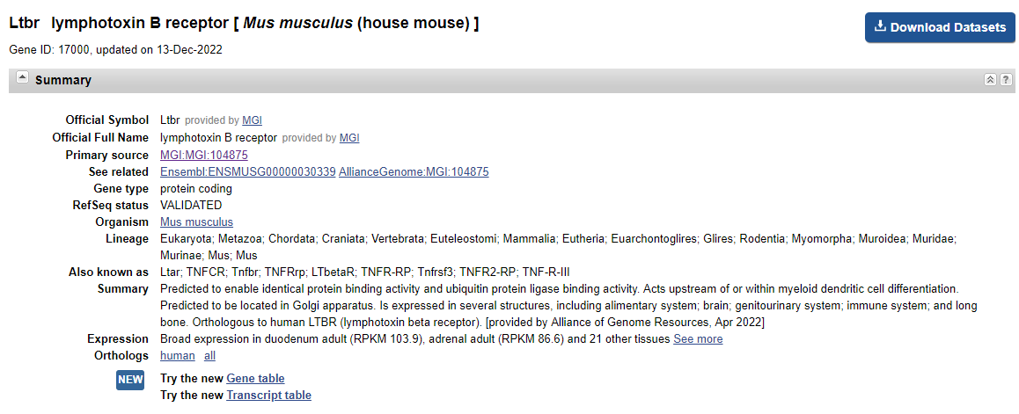
Gene Information
Source: https://www.ncbi.nlm.nih.gov/

Slide 6
Transcript Information
The gene has 3 transcripts, all transcripts are shown below:
The strategy is based on the design of Ltbr-201 transcript, the transcription is shown below:
Source: https://www.ensembl.org

Slide 7
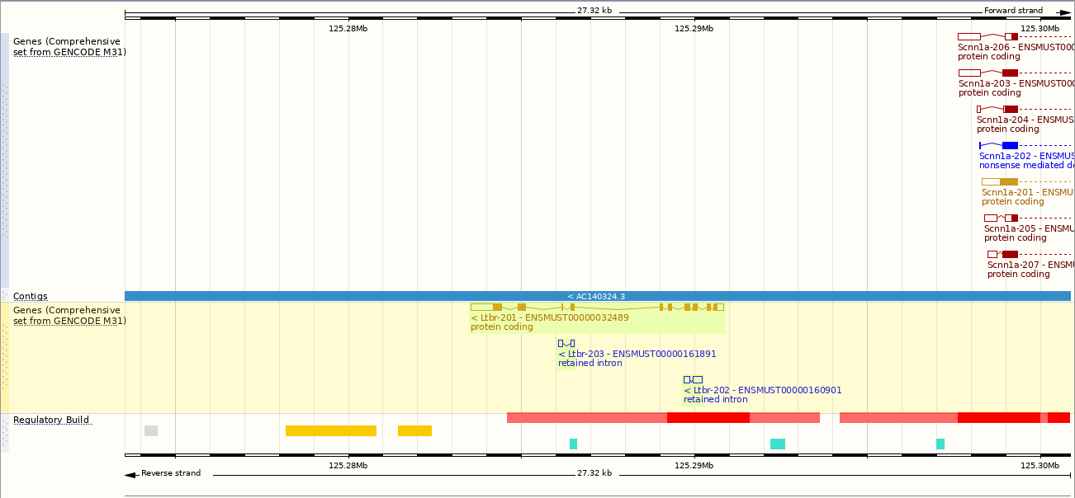
Genomic Information
Source: : https://www.ensembl.org

Slide 8
Protein Information
Source: : https://www.ensembl.org

Slide 9
Mouse Phenotype Information (MGI)
Homozygotes for a targeted null mutation lack Peyer's patches, colon-associated lymphoid tissues, and lymph nodes. Mutants also exhibit severely reduced numbers of NK cells and increased susceptibility to Theiler's murine encephalomyelitis virus.
Source: https://www.informatics.jax.org

Slide 10
Important Information
Ltbr is located on Chr6. If the knockout mice are crossed with other mouse strains to obtain double homozygous mutant offspring, please avoid the situation that the second gene is on the same chromosome.
The flox region is about 4kb away from the gene Scnn1a, this strategy may affect the normal function of gene Scnn1a.
The insertion of 1st Loxp may distroy the normal function of gene Ltbr.
This Strategy is designed based on genetic information in existing databases. Due to the complexity of biological processes, all risk of loxp insertion on gene transcription, RNA splicing and protein translation cannot be predicted at the existing technology level.

