Slide 1
Fau Cas9-KO Strategy
Designer: Jinling Wang Reviewer: Lingyan Wu Design Date: 2023-9-1

Slide 2
Overview
Target Gene Name
Fau
Project Type
Cas9-KO
Genetic Background
C57BL/6JGpt

Slide 3
Strain Strategy
Schematic representation of CRISPR-Cas9 engineering used to edit the Fau gene.

Slide 4
Technical Information
The Fau gene has 9 transcripts. According to the structure of Fau gene, exon1-exon4 of Fau-203 (ENSMUST00000179142.2) transcript is recommended as the knockout region. The region contains all coding sequence. Knocking out the region will result in disruption of protein function.
In this project we use CRISPR-Cas9 technology to modify Fau gene. The brief process is as follows: gRNAs were transcribed in vitro. Cas9 and gRNAs were microinjected into the fertilized eggs of C57BL/6JGpt mice. Fertilized eggs were transplanted to obtain positive F0 mice which were confirmed by PCR and on-target amplicon sequencing. A stable F1-generation mouse strain was obtained by mating positive F0-generation mice with C57BL/6JGpt mice and confirmation of the desired mutant allele was carried out by PCR and on-target amplicon sequencing.

Slide 5
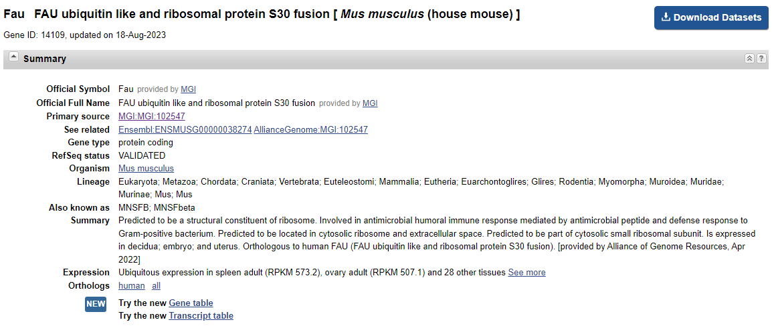
Gene Information
Source: https://www.ncbi.nlm.nih.gov/

Slide 6
Transcript Information
The gene has 9 transcripts,all transcripts are shown below:
The strategy is based on the design of Fau-203 transcript, the transcription is shown below:
Source: https://www.ensembl.org

Slide 7
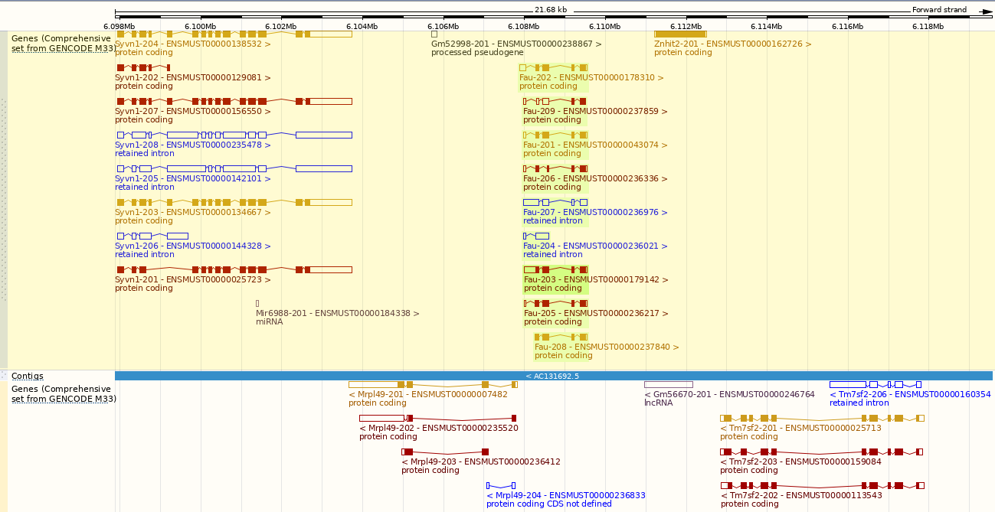
Genomic Information
Source: : https://www.ensembl.org

Slide 8
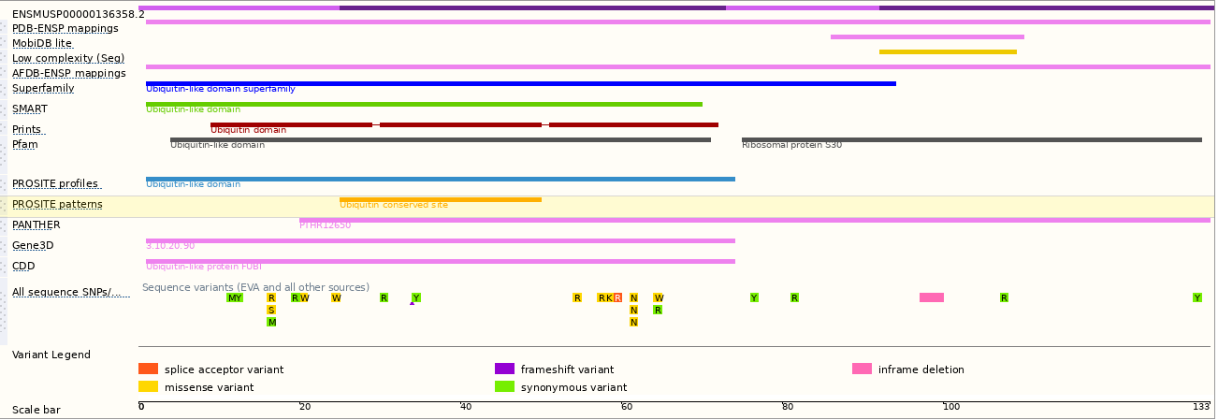
Protein Information
Source: : https://www.ensembl.org

Slide 9
Mouse Phenotype Information (MGI)
Female mice heterozygous for a null allele exhibit maternal effect defect impacting embryo survival.
Source: https://www.informatics.jax.org

Slide 10
Important Information
Fau is located on Chr9. If the knockout mice are crossed with other mouse strains to obtain double homozygous mutant offspring, please avoid the situation that the second gene is on the same chromosome.
This Strategy is designed based on genetic information in existing databases. Due to the complexity of biological processes, all risks of the mutation on gene transcription, RNA splicing and protein translation cannot be predicted at the existing technology level.
Mrpl49 gene and Znhit2 gene are about 0.45kb and 1.3kb far away from the Targeted gene, so this strategy may directly destroy the function of Mrpl49 gene and Znhit2 gene.
There is only one available gRNA at the ATG site.

Slide 11
Reference 1

