Slide 1
Wdr4 Cas9-KO Strategy
Designer: Jinling Wang Reviewer: Rui Xiong Design Date: 2023-8-9

Slide 2
Overview
Target Gene Name
Wdr4
Project Type
Cas9-KO
Genetic Background
C57BL/6JGpt

Slide 3
Strain Strategy
1
3
4
7
8
11
1
3
8
11
Schematic representation of CRISPR-Cas9 engineering used to edit the Wdr4 gene.

Slide 4
Technical Information
The Wdr4 gene has 14 transcripts. According to the structure of Wdr4 gene, exon4-exon7 of Wdr4-207 (ENSMUST00000171171.9) transcript is recommended as the knockout region. The region contains 430bp coding sequence. Knocking out the region will result in disruption of protein function.
In this project we use CRISPR-Cas9 technology to modify Wdr4 gene. The brief process is as follows: gRNAs were transcribed in vitro. Cas9 and gRNAs were microinjected into the fertilized eggs of C57BL/6JGpt mice. Fertilized eggs were transplanted to obtain positive F0 mice which were confirmed by PCR and on-target amplicon sequencing. A stable F1-generation mouse strain was obtained by mating positive F0-generation mice with C57BL/6JGpt mice and confirmation of the desired mutant allele was carried out by PCR and on-target amplicon sequencing.

Slide 5
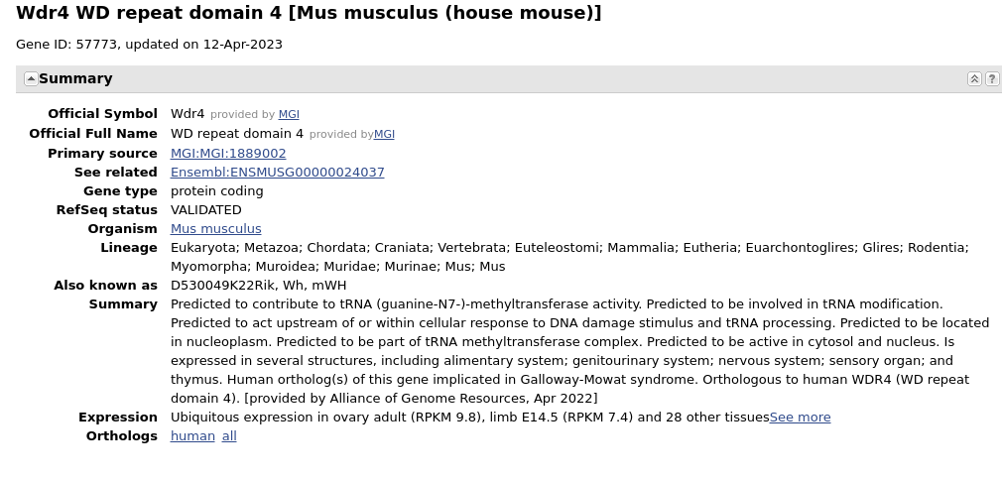
Gene Information
Source: https://www.ncbi.nlm.nih.gov/

Slide 6
Transcript Information
The gene has 14 transcripts,all transcripts are shown below:
The strategy is based on the design of Wdr4-207 transcript, the transcription is shown below:
Source: https://www.ensembl.org

Slide 7
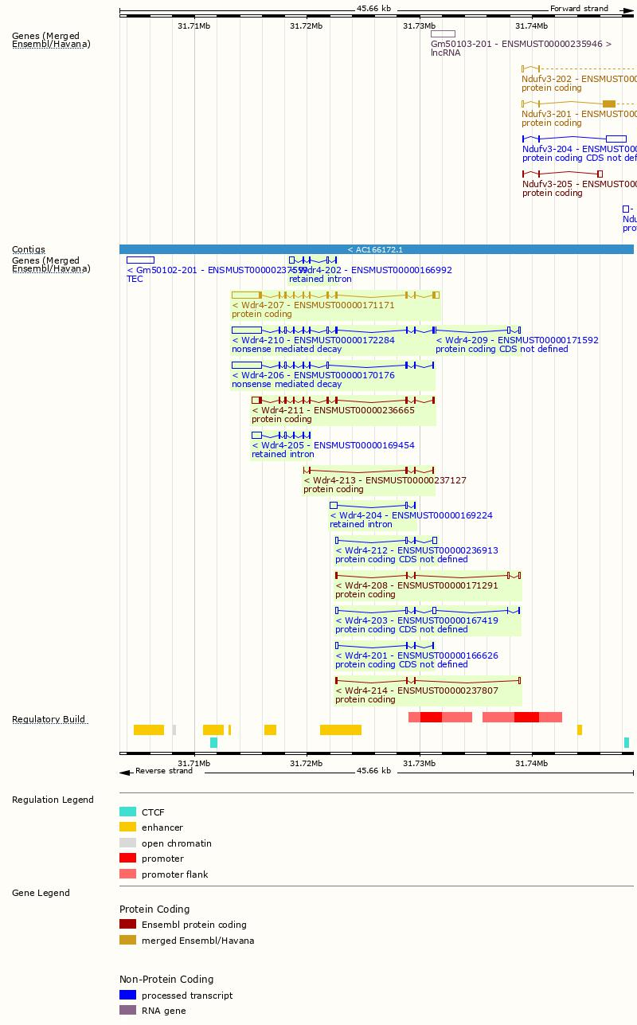
Genomic Information
Source: : https://www.ensembl.org

Slide 8
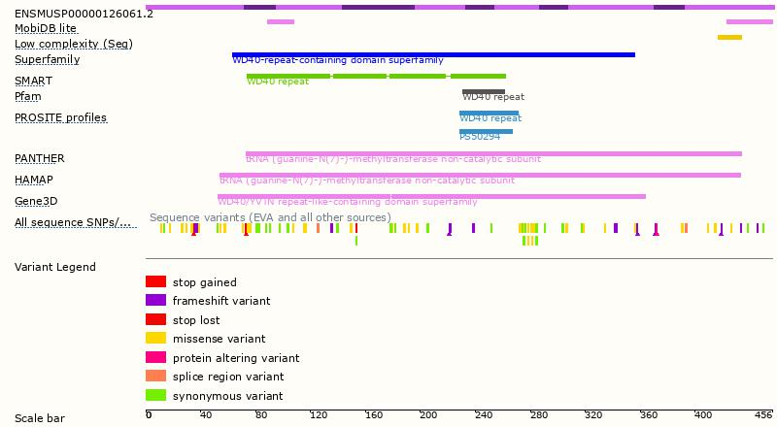
Protein Information
Source: : https://www.ensembl.org

Slide 9
Mouse Phenotype Information (MGI)
Mice homozygous for a null allele display lethality during organogenesis with increased apoptosis and DNA damage.
Source: https://www.informatics.jax.org

Slide 10
Important Information
Wdr4 is located on Chr17. If the knockout mice are crossed with other mouse strains to obtain double homozygous mutant offspring, please avoid the situation that the second gene is on the same chromosome.
This Strategy is designed based on genetic information in existing databases. Due to the complexity of biological processes, all risks of the mutation on gene transcription, RNA splicing and protein translation cannot be predicted at the existing technology level.

