Slide 1
Foxo1 Cas9-KO Strategy
Designer: Jinling Wang Reviewer: lingyan Wu
Design Date: 2023-2-16

Slide 2
Overview
Target Gene Name
Foxo1
Project Type
Cas9-KO
Genetic Background
C57BL/6JGpt

Slide 3
Strain Strategy
1
2
2
Schematic representation of CRISPR-Cas9 engineering used to edit the Foxo1 gene.

Slide 4
Technical Information
The Foxo1 gene has1 transcripts. According to the structure of Foxo1 gene, exon1-10 of Foxo1-201 (ENSMUST00000053764.7) transcript is recommended as the knockout region. The region contains promoter region and exon1. Knocking out the region will result in disruption of protein function.
In this project we use CRISPR/Cas9 technology to modify Foxo1 gene. The brief process is as follows: gRNA was transcribed in vitro.Cas9 and gRNA were microinjected into the fertilized eggs of C57BL/6J mice.Fertilized eggs were transplanted to obtain positive F0 mice which were confirmed by PCR and sequencing. A stable F1 generation mouse model was obtained by mating positive F0 generation mice with C57BL/6J mice.

Slide 5
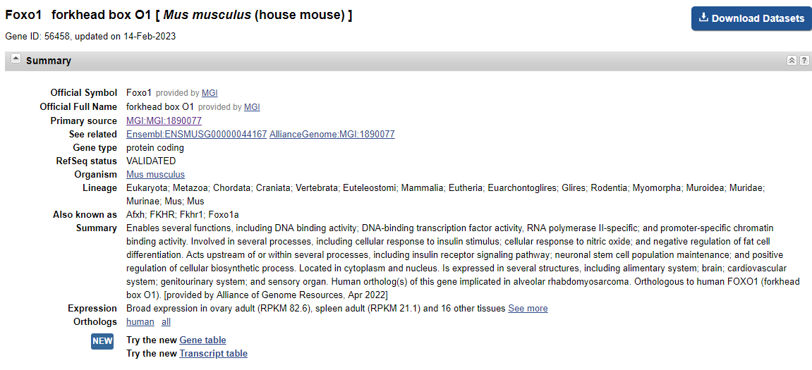
Gene Information
Source: https://www.ncbi.nlm.nih.gov/

Slide 6
Transcript Information
The gene has 1 transcripts, all transcripts are shown below:
The strategy is based on the design of Foxo1-201 transcript, the transcription is shown below:
Source: https://www.ensembl.org

Slide 7
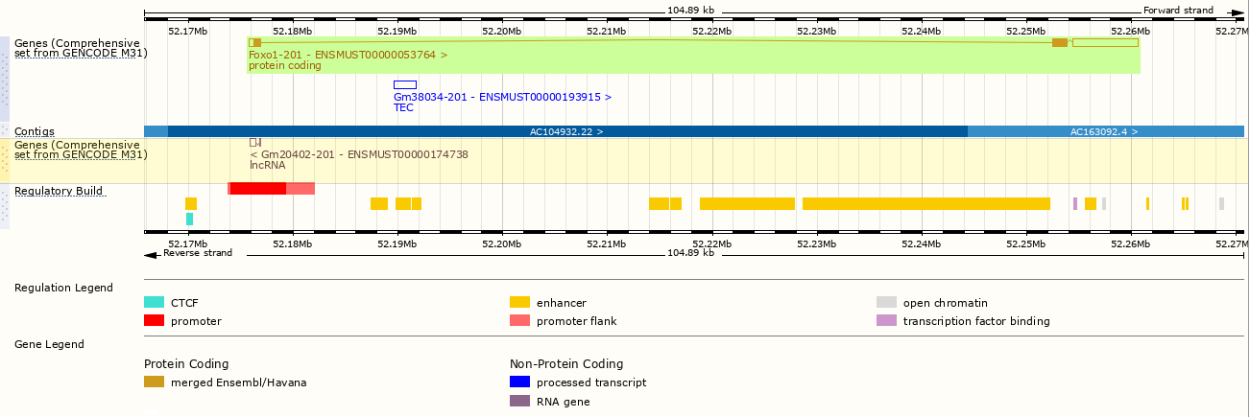
Genomic Information
KO region
Source: : https://www.ensembl.org

Slide 8
Protein Information
Source: : https://www.ensembl.org

Slide 9
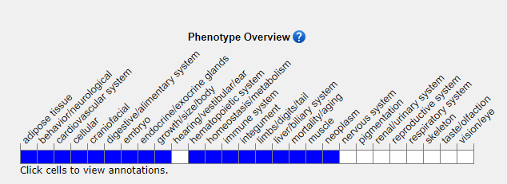
Mouse Phenotype Information (MGI)
Homozygous null embryos die at E10.5-E11.5 from vasculature defects. Heterozygote null mice have slightly elevated glycogen levels. Conditionally targeted homozygotes display hemangiomas or defects in nave T cell homeostasis depending on the targeted cell type.
Source: https://www.informatics.jax.org

Slide 10
Important Information
The Foxo1 gene is located on the Chr3. If the knockout mice are crossed with other mice strains to obtain double gene positive homozygous mouse offspring, please avoid the two genes on the same chromosome.
This Strategy is designed based on genetic information in existing databases. Due to the complexity of gene transcription and translation processes, all risks cannot be predicted under existing information.
The knoclout region contains gene Gm20402(lncRNA).

