Slide 1
Jak3 Cas9-CKO Strategy
Designer: Jinling Wang Reviewer: Lingyan Wu Design Date: 2023-2-14

Slide 2
Overview
Target Gene Name
Jak3
Project Type
Cas9-CKO
Genetic Background
C57BL/6JGpt

Slide 3
Strain Strategy
7
17
2
6
7
17
18
24
2
6
7
17
18
24
2
6
18
24
Schematic representation of CRISPR-Cas9 engineering used to edit the Jak3 gene.

Slide 4
Technical Information
The Jak3 gene has 5 transcripts. According to the structure of Jak3 gene, exon7-17 of Jak3-201 (ENSMUST00000051995.14) transcript is recommended as the knockout region. The region contains 1486bp coding sequence. Knock out the region will result in disruption of protein function.
In this project we use CRISPR-Cas9 technology to modify Jak3 gene. The brief process is as follows: CRISPR-Cas9 system and Donor were microinjected into the fertilized eggs of C57BL/6JGpt mice. Fertilized eggs were transplanted to obtain positive F0 mice which were confirmed by PCR and on-target amplicon sequencing. A stable F1-generation mouse strain was obtained by mating positive F0-generation mice with C57BL/6JGpt mice and confirmation of the desired mutant allele was carried out by PCR and on-target amplicon sequencing.
The flox mice will be knocked out after mating with mice expressing Cre recombinase, resulting in the loss of function of the target gene in specific tissues and cell types.

Slide 5
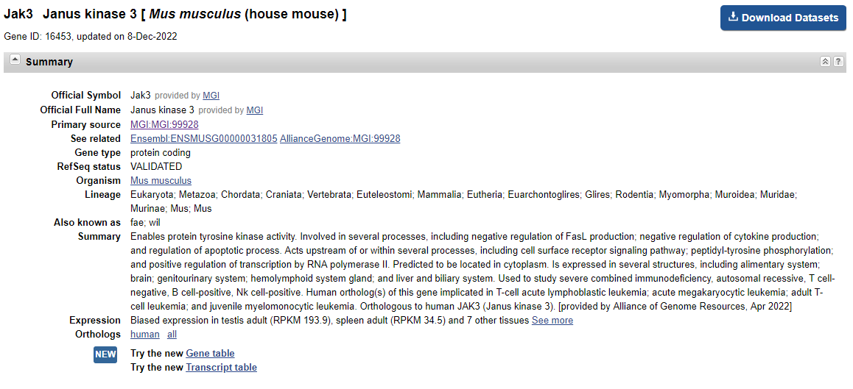
Gene Information
Source: https://www.ncbi.nlm.nih.gov/

Slide 6
Transcript Information
The gene has 5 transcripts, all transcripts are shown below:
The strategy is based on the design of Jak3-201 transcript, the transcription is shown below:
Source: https://www.ensembl.org

Slide 7
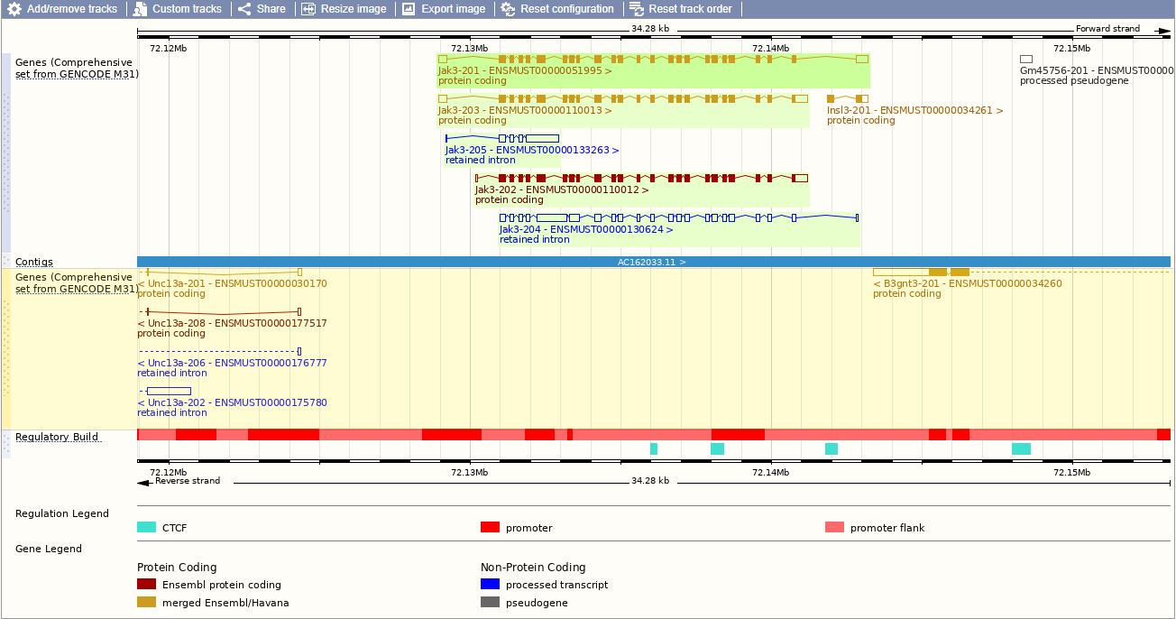
Genomic Information
Source: : https://www.ensembl.org

Slide 8
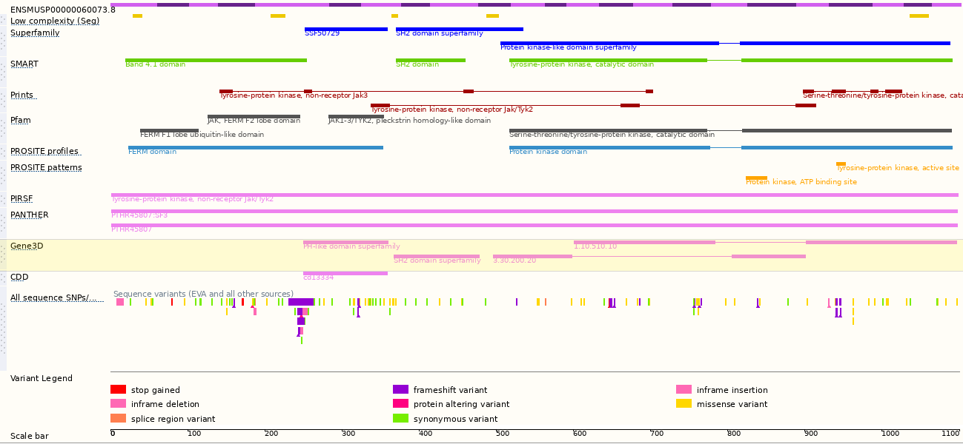
Protein Information
Source: : https://www.ensembl.org

Slide 9
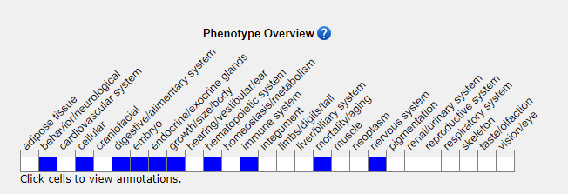
Mouse Phenotype Information (MGI)
Mice homozygous for a knock-out allele exhibit impaired B cell development, small thymi and T cell proliferate. Point mutation homozygotes develop autoimmune inflammatory bowel disease, decreased susceptibility to malaria infection and/or increased susceptibility to bacterial infection.
Source: https://www.informatics.jax.org

Slide 10
Important Information
Jak3 is located on Chr8. If the knockout mice are crossed with other mouse strains to obtain double homozygous mutant offspring, please avoid the situation that the second gene is on the same chromosome.
The flox region is about 4.5kb away from the gene Insl3, this strategy may affect the normal function of gene Insl3.
The insertion of 1st Loxp directely distroy the transcript 204、205.
This Strategy is designed based on genetic information in existing databases. Due to the complexity of biological processes, all risk of loxp insertion on gene transcription, RNA splicing and protein translation cannot be predicted at the existing technology level.

