Slide 1
Strn4 Cas9-CKO Strategy
Designer: Jinling Wang Reviewer: Rui Xiong Design Date: 2022-12-07

Slide 2
Overview
Target Gene Name
Strn4
Project Type
Cas9-CKO
Genetic Background
C57BL/6JGpt

Slide 3
Strain Strategy
Schematic representation of CRISPR-Cas9 engineering used to edit the Strn4 gene.

Slide 4
Technical Information
The Strn4 gene has 14 transcripts. According to the structure of Strn4 gene, exon2-3 of Strn4-201 (ENSMUST00000019220.16) transcript is recommended as the knockout region. The region contains 178bp of coding sequences. Knocking out the region will result in disruption of protein function.
In this project we use CRISPR-Cas9 technology to modify Strn4 gene. The brief process is as follows: CRISPR-Cas9 system and Donor were microinjected into the fertilized eggs of C57BL/6JGpt mice. Fertilized eggs were transplanted to obtain positive F0 mice which were confirmed by PCR and on-target amplicon sequencing. A stable F1-generation mouse strain was obtained by mating positive F0-generation mice with C57BL/6JGpt mice and confirmation of the desired mutant allele was carried out by PCR and on-target amplicon sequencing.
The flox mice will be knocked out after mating with mice expressing Cre recombinase, resulting in the loss of function of the target gene in specific tissues and cell types.

Slide 5
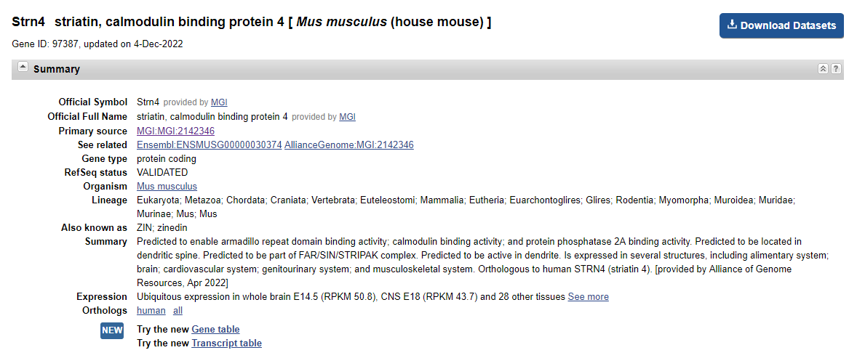
Gene Information
Source: https://www.ncbi.nlm.nih.gov/

Slide 6
Transcript Information
The gene has14 transcripts, all transcripts are shown below:
The strategy is based on the design of Strn4-201 transcript, the transcription is shown below:
Source: https://www.ensembl.org

Slide 7
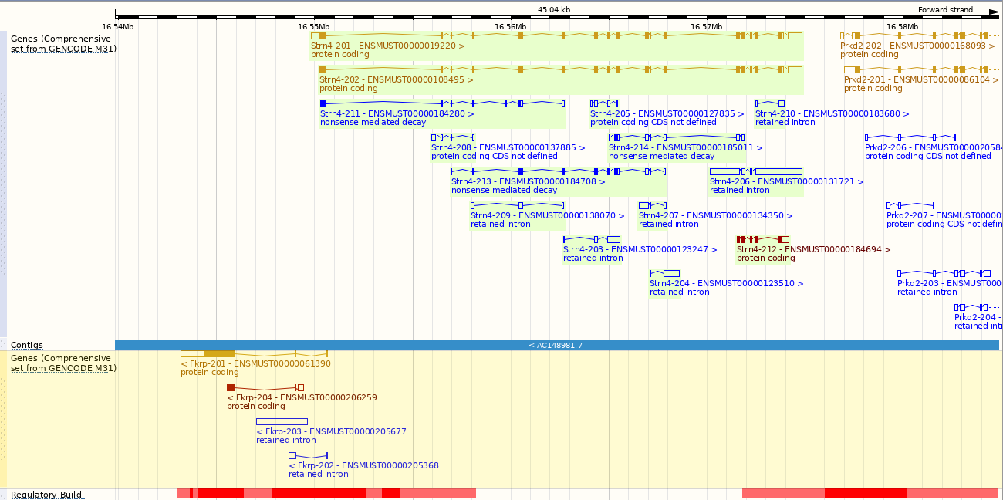
Genomic Information
Source: : https://www.ensembl.org

Slide 8
Protein Information
Source: : https://www.ensembl.org

Slide 9
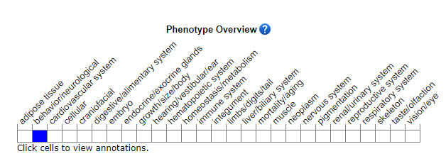
Mouse Phenotype Information (MGI)
Source: https://www.informatics.jax.org

Slide 10
Important Information
Strn4 is located on Chr7. If the knockout mice are crossed with other mouse strains to obtain double homozygous mutant offspring, please avoid the situation that the second gene is on the same chromosome.
This strategy may not affect the transcripts of 203、204、205、206、207、209、210、212.
The flox region is about 5kb away from the gene Fkrp, this strategy may affect the nomal function of gene Fkrp.
This Strategy is designed based on genetic information in existing databases. Due to the complexity of biological processes, all risk of loxp insertion on gene transcription, RNA splicing and protein translation cannot be predicted at the existing technology level.

