Slide 1
Fbxl2 Cas9-KO Strategy
Designer: Reviewer: Design Date:

Slide 2
Project Overview
Project Name Fbxl2
Project type Cas9-KO
Strain background C57BL/6JGpt

Slide 3
Knockout strategy
This model will use CRISPR/Cas9 technology to edit the Fbxl2 gene. The schematic diagram is as follows:
1
2
3
15
1
3
15

Slide 4
Technical routes
➣ The Fbxl2 gene has 6 transcripts. According to the structure of Fbxl2 gene, exon2 of Fbxl2-201(ENSMUST00000035090.13) transcript is recommended as the knockout region.The region contains 62bp coding sequence. Knock out the region will result in disruption of protein function. ➣ In this project we use CRISPR/Cas9 technology to modify Fbxl2 gene. The brief process is as follows: sgRNA was transcribed in vitro.Cas9 and sgRNA were microinjected into the fertilized eggs of C57BL/6JGpt mice.Fertilized eggs were transplanted to obtain positive F0 mice which were confirmed by PCR and sequencing. A stable F1 generation mouse model was obtained by mating positive F0 generation mice with C57BL/6JGpt mice.

Slide 5
Notice
➣ The Fbxl2 gene is located on the Chr9. If the knockout mice are crossed with other mice strains to obtain double gene positive homozygous mouse offspring, please avoid the two genes on the same chromosome. ➣ This strategy is designed based on genetic information in existing databases.Due to the complexity of biological processes,all risk of the gene knockout on gene transcription, RNA splicing and protein translation cannot be predicted at the existing technology level.

Slide 6
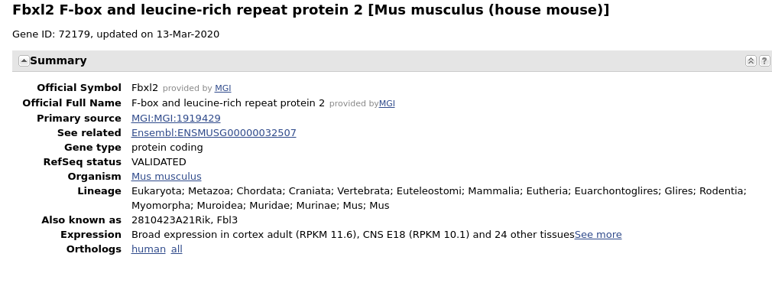
Gene information （NCBI）

Slide 7
Transcript information（Ensembl）
The gene has 6 transcripts,all transcripts are shown below:
The strategy is based on the design of Fbxl2-201 transcript,the transcription is shown below:

Slide 8
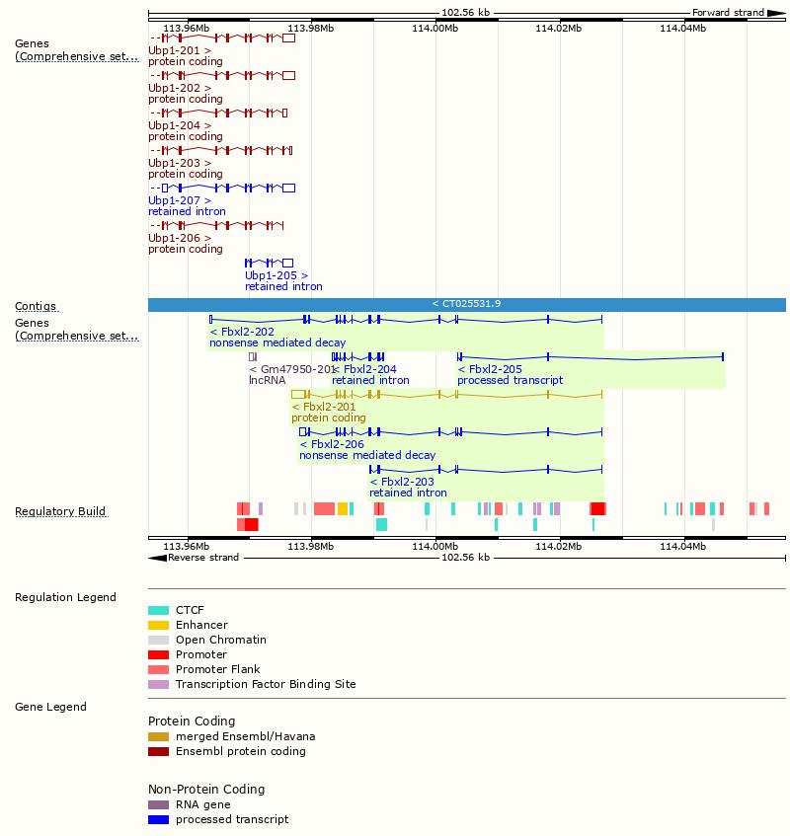
Genomic location distribution

Slide 9
Protein domain

Slide 10
If you have any questions, you are welcome to inquire. Tel: 025-5864 1534

